Slide 1

{
“name”: “gWaves”,
“motto”: “The sky calls to us.”,
“challenge”: “Mayday, Mayday, Mayday!”,
“description”: “Web-based App Radiation Management (WARM)”, “gitHub" : “https://github.com/4543386CanadaInc/SpaceApps2017", "email" : “vroch@edu.uwaterloo.ca", "mobile" : "(613) 408-2495" }

Slide 2



gWaves Team Members
{
“name”: “Vincent Roch”,
“role”: “team leader”, “occupation" : “uWaterloo Student - Software Engineering", "email" : “vroch@edu.uwaterloo.ca", "mobile" : "(613) 408-2495" }
{
“name”: “Johanne Bordeleau, P.Eng.”,
“role”: “software engineer having fun”, “occupation" : “Senior Software Engineer,", "email" : “johannebordeleau@bell.net", "mobile" : "(613) 791-6655" }
{
“name”: “Johnny Slater”,
“role”: “SME day dreaming”, "title" : “System Architect", "email" : “slater_johnny@hotmail.com", "mobile" : "(613) 762-4015" }

Slide 3
The Problem
Exposures to ionizing radiation represent real health hazards to all flight travellers
Prolonged ionizing radiation exposures may lead to biological effects such as: damage of immunization system, cancer, and hereditary effects
In 2016, there were over 3 billion flight passengers (crews not included)
Flight attendants spend on average 1400 hours in the air per year and pilots no more that 1000 hours per year
How do we ensure ionizing radiation exposures for all flight travellers are within the established dose limits?

Slide 4
The Opportunity
Provide a simple web-based application that enables
Flight passengers to monitor their individual ionizing radiation exposure dosage on a per flight and cumulative basis (year to date)
Flight crew members to monitor their individual ionizing radiation exposure dosage on a per flight and cumulative basis (year to date, last 5 years)
Managers to monitor ionizing radiation exposure dosage for all flight crew members within an establishment with the help of threshold notifications and flight assignment planning
Incorporate notifications of events that may impact radiation exposure, such as space weather events

Slide 5
System Context

Slide 6
Planned System Use Cases

Slide 7


WARM Solution Topology
Deployment on private Domain (Fleepy) requiring authorization of REST web services with OAUTH
Channel App Client
REST Interaction APIs and adapters for Radiation/…
Hotspot{flightId}
AlternateRoute{flightId}
IonizingRadiation{flightId}
GalacticCosmicRadiation{flightId}
SolarCosmicRadiation{flightId}

Slide 8
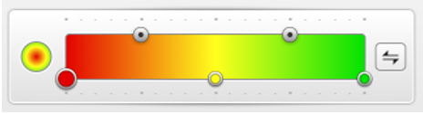
WARM Original Mock-Up
Layers and overlay controls
Mouse Hover over waypoint displays Data over a pop-up
WayPoint Data
Adjustable gradient based on radiation level threshold

Slide 9
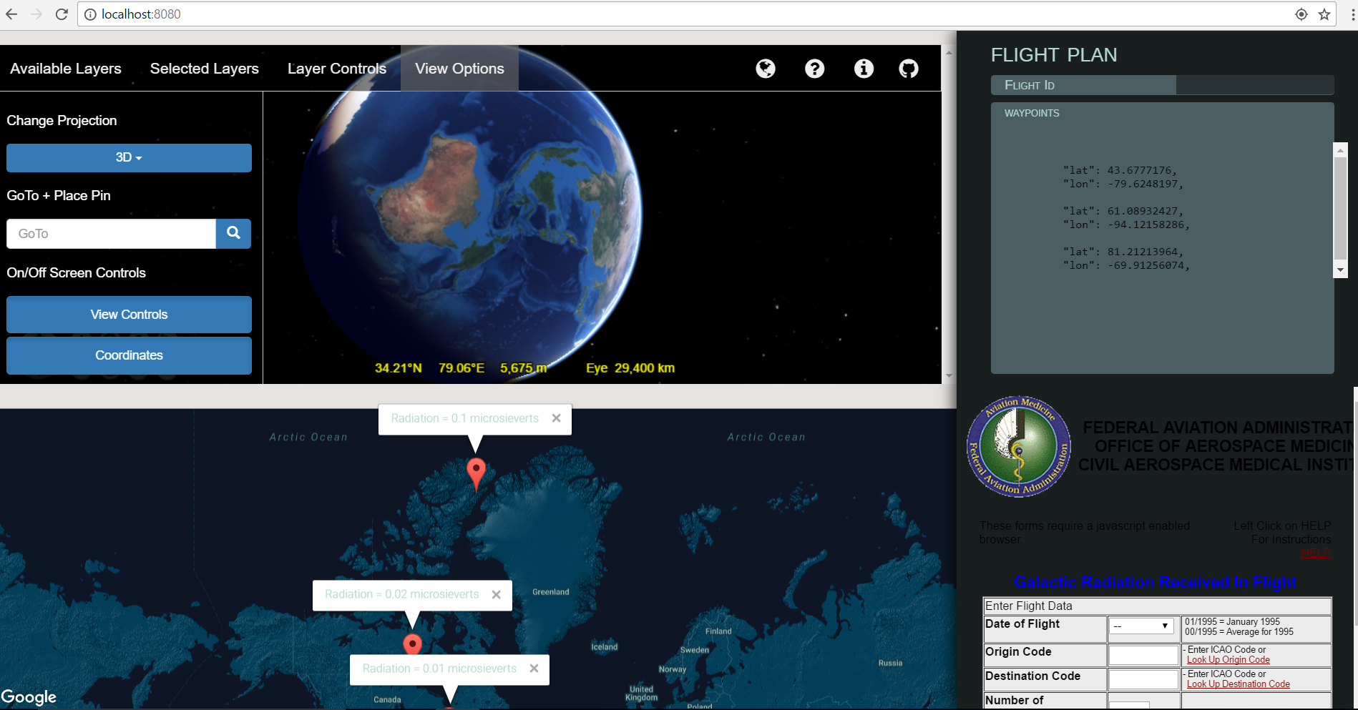
WARM Actual Prototype (1 / 3)

Slide 10
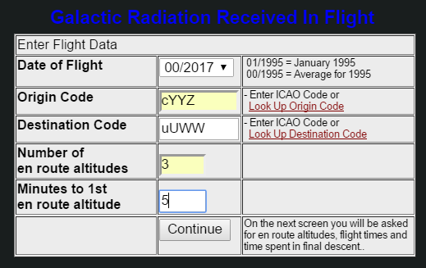
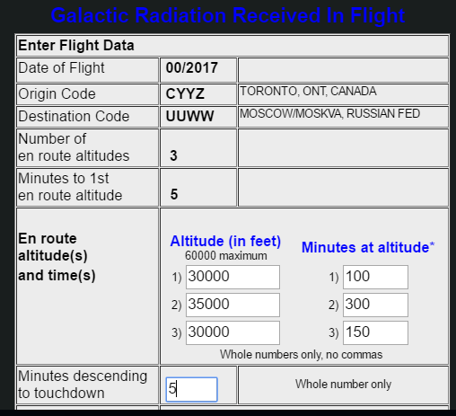
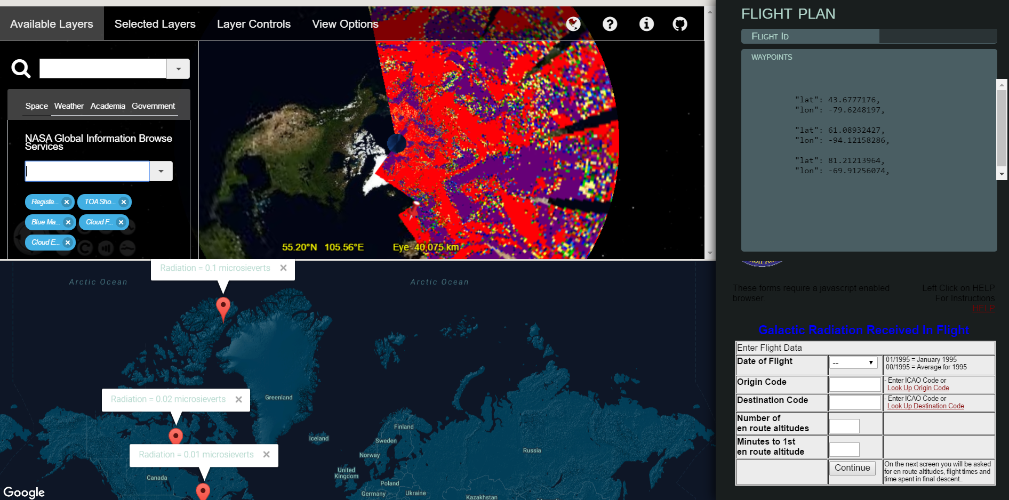
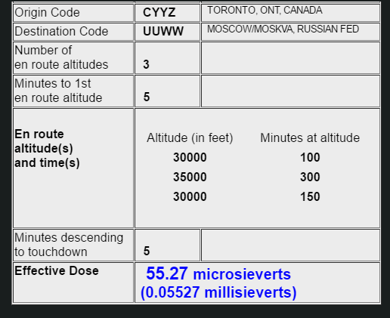
WARM Actual Prototype (2 / 3)

Slide 11
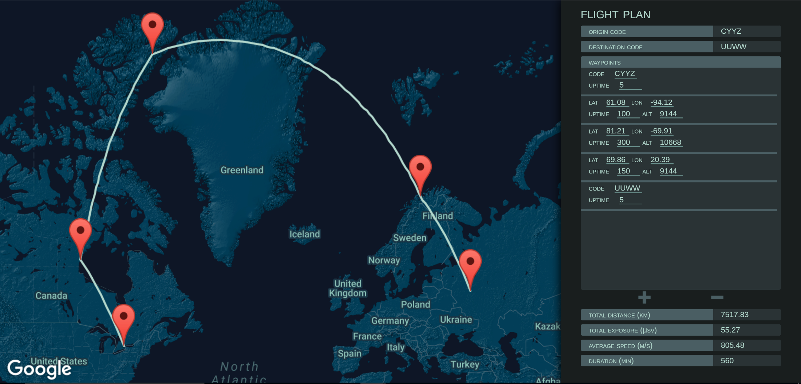
WARM Actual Prototype (3 / 3)

Slide 12
Lessons Learned
Some API Enterprise servers enforce quota management and rate limiting API calls – API key being temporarily blocked from making further requests. Usability of offered APIs is limited when quota management is too strict.
Some visual APIs should provide standard-based visual API specs (Swagger).
No security/authentication was implemented (no OAUTH)
No API management (product lifecycle) was implemented
ArcGIS API for JavaScript is really easier to use
It would have been preferable to use a framework/automation tools such as Bluemix and/or API Connect, Loopback, etc
NASA visual data offered in GP2 not supported by some browsers
1-2 days is really short for new functionality using advanced analytics. Assembly and reuse work instead of development.
Assembling existing non-standard APIs

